Slide 1
Pre-workshop Setup

Slide 2
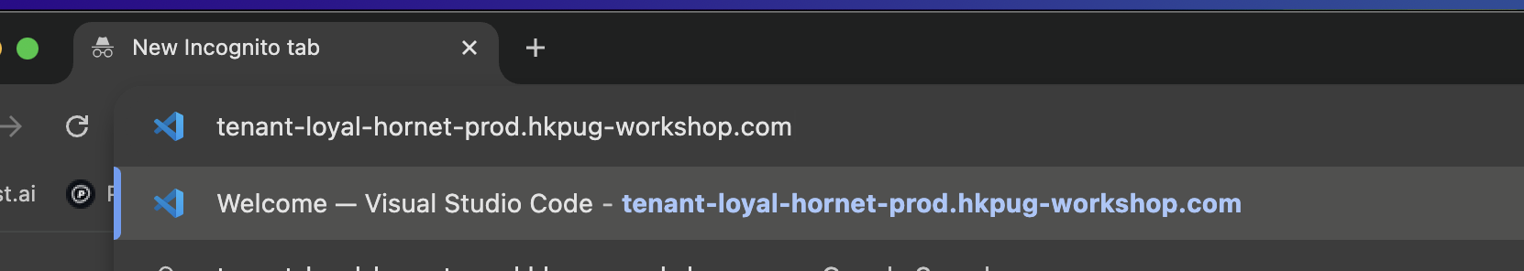
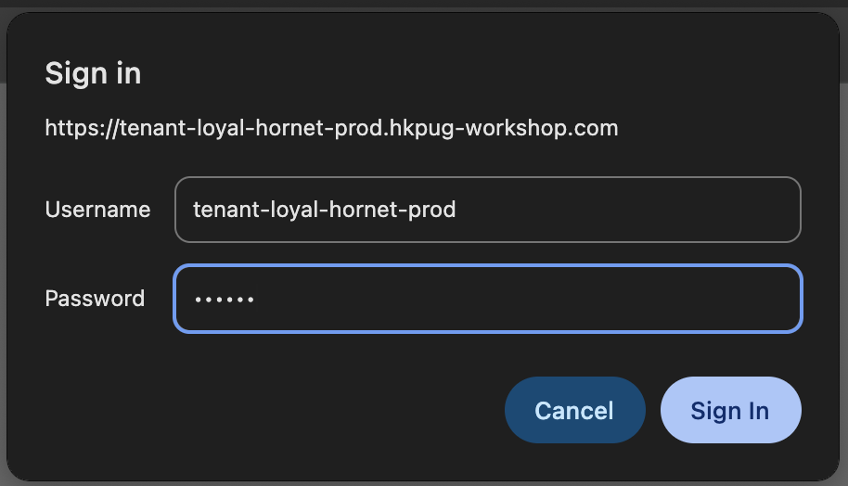
Login to VS Code
Make sure you have received your Online Vscode URL and Password!

Slide 3
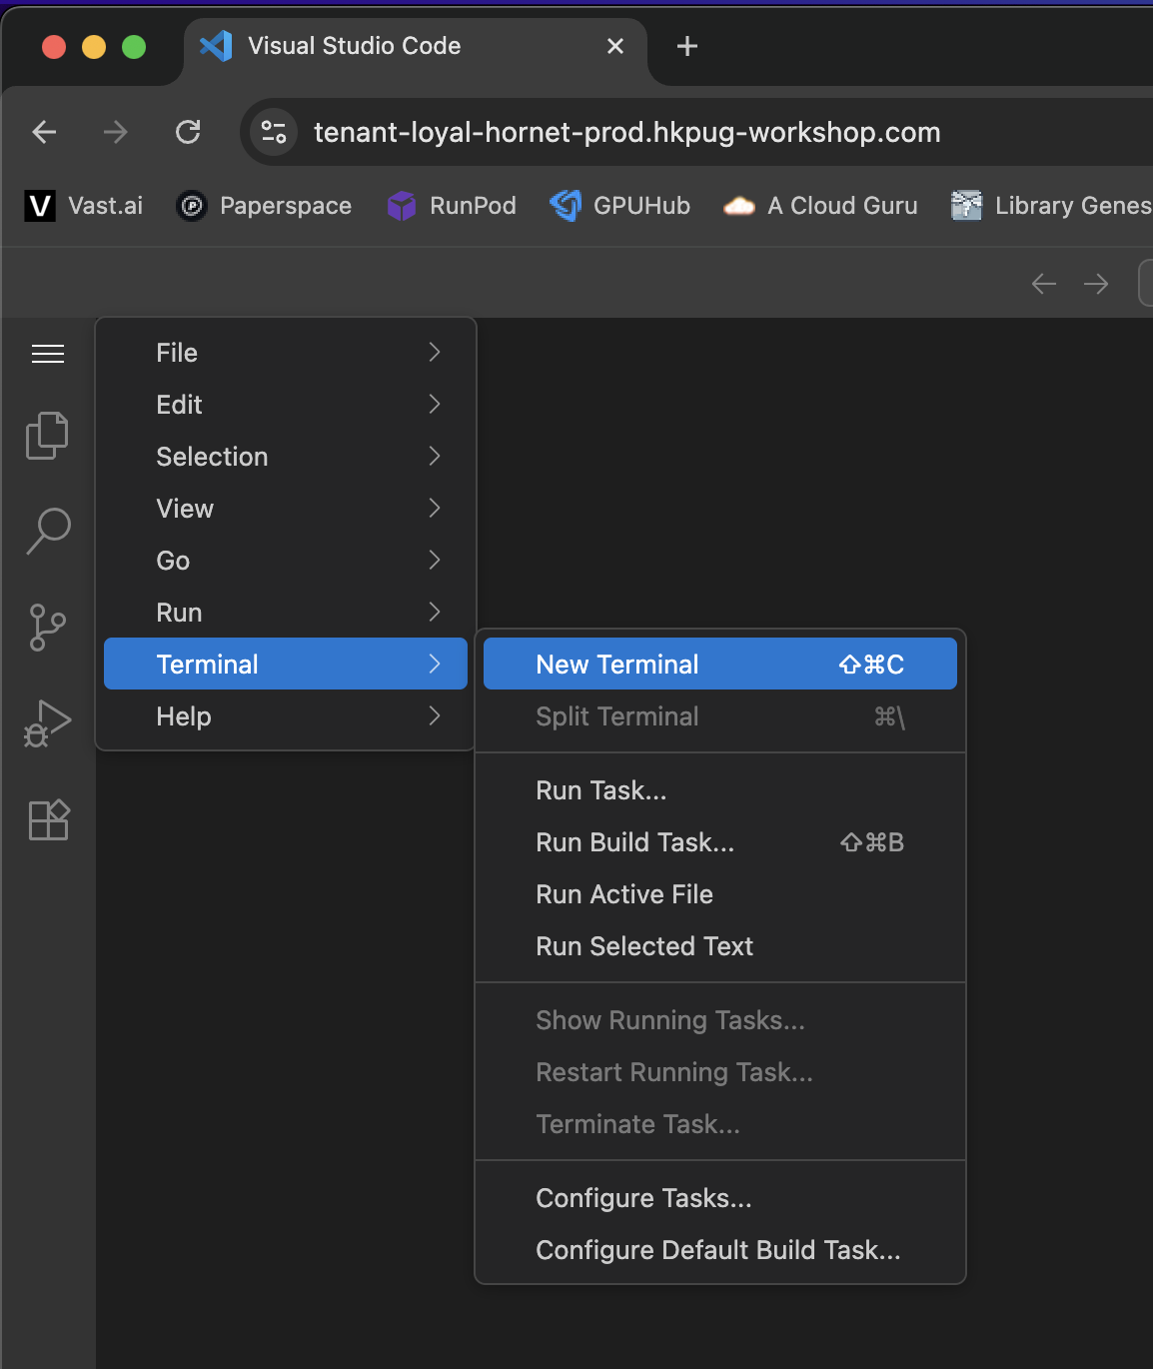
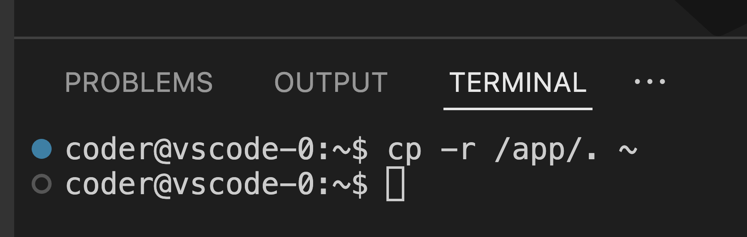
Setup VS Code [1]
1
2
3
4
Run cp -r /app/. ~

Slide 4
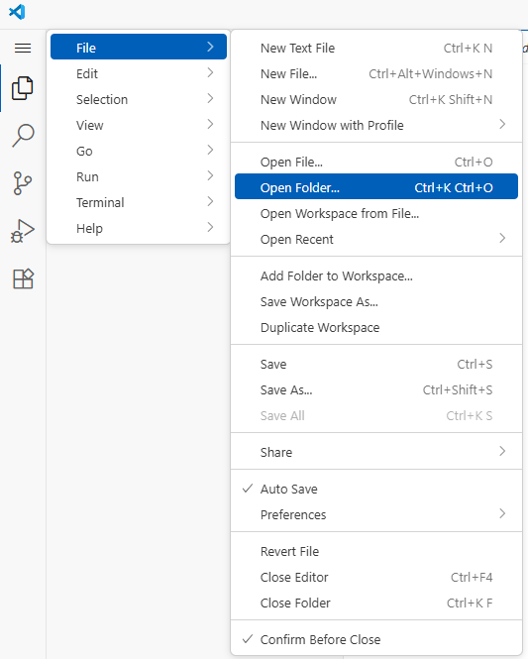
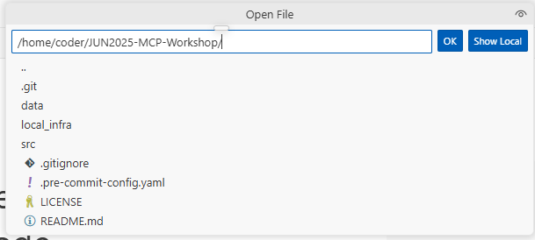
Setup VS Code [2]
1. Open Folder
2. Go to JUN2025-MCP-Workshop

Slide 5
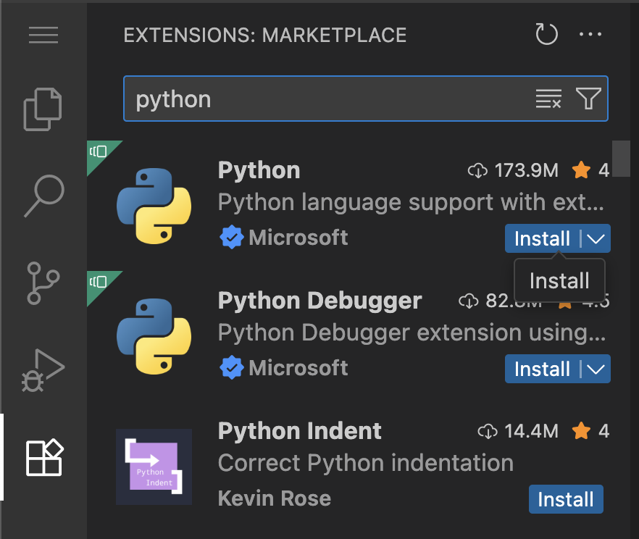
Setup VS Code [3]
2. Search for “reload”
3. Click Install
1. Go to VSCode Extension

Slide 6
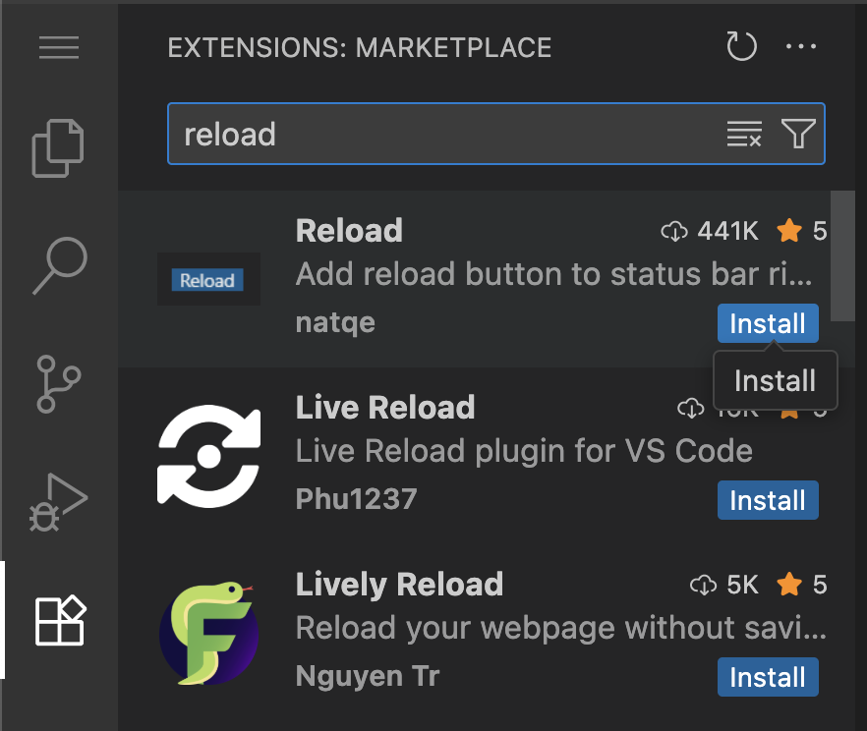
Setup VS Code [4]
2. Search for “reload”
3. Click Install
1. Go to VSCode Extension

Slide 7
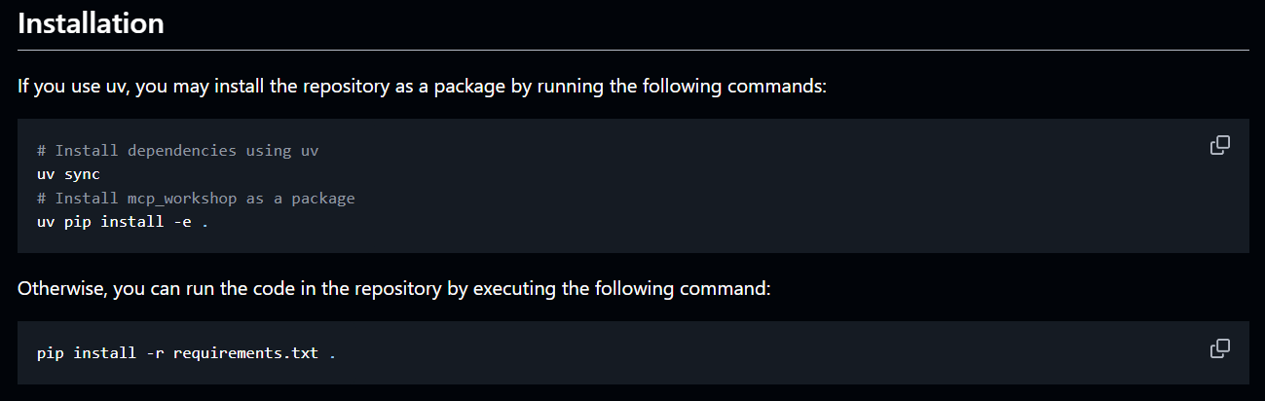
Install Dependencies for Workshop
Remember to first do cd src/
Follow the JUN2025-MCP-Workshop/src/README.md to install with uv.
Note that uv should be pre-installed in our cluster already.

Slide 8
MCP Server 101
Python User Group Workshop
28 June 2025

Slide 9

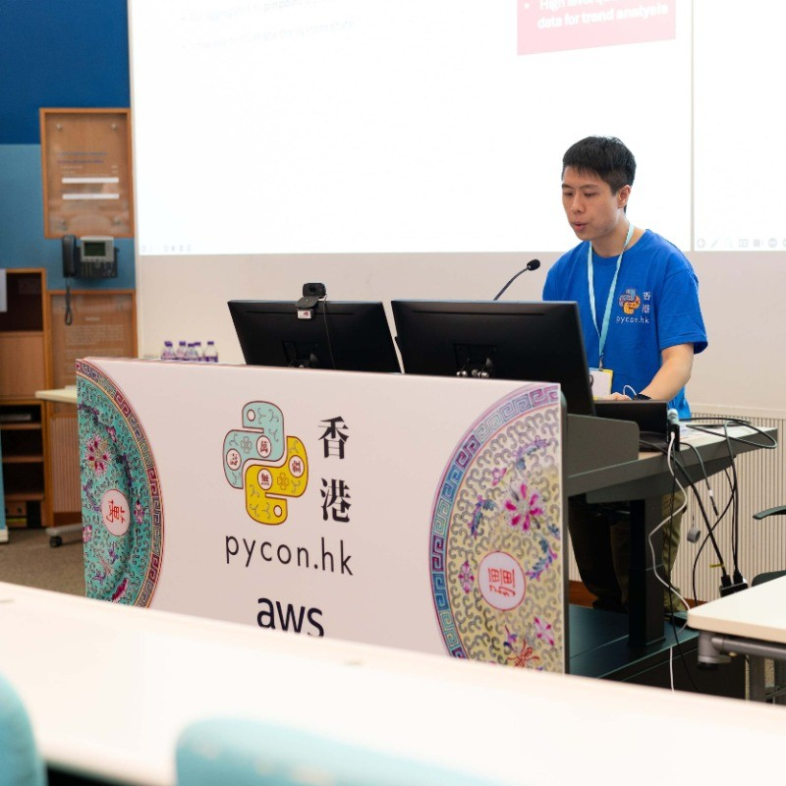
Quick Introduction
Speaker: Henry Wong
Data Scientist
Researcher
Infrastructure & Support: Alex Au
Cloud Engineer
Ex-Silicon engineer

Slide 10
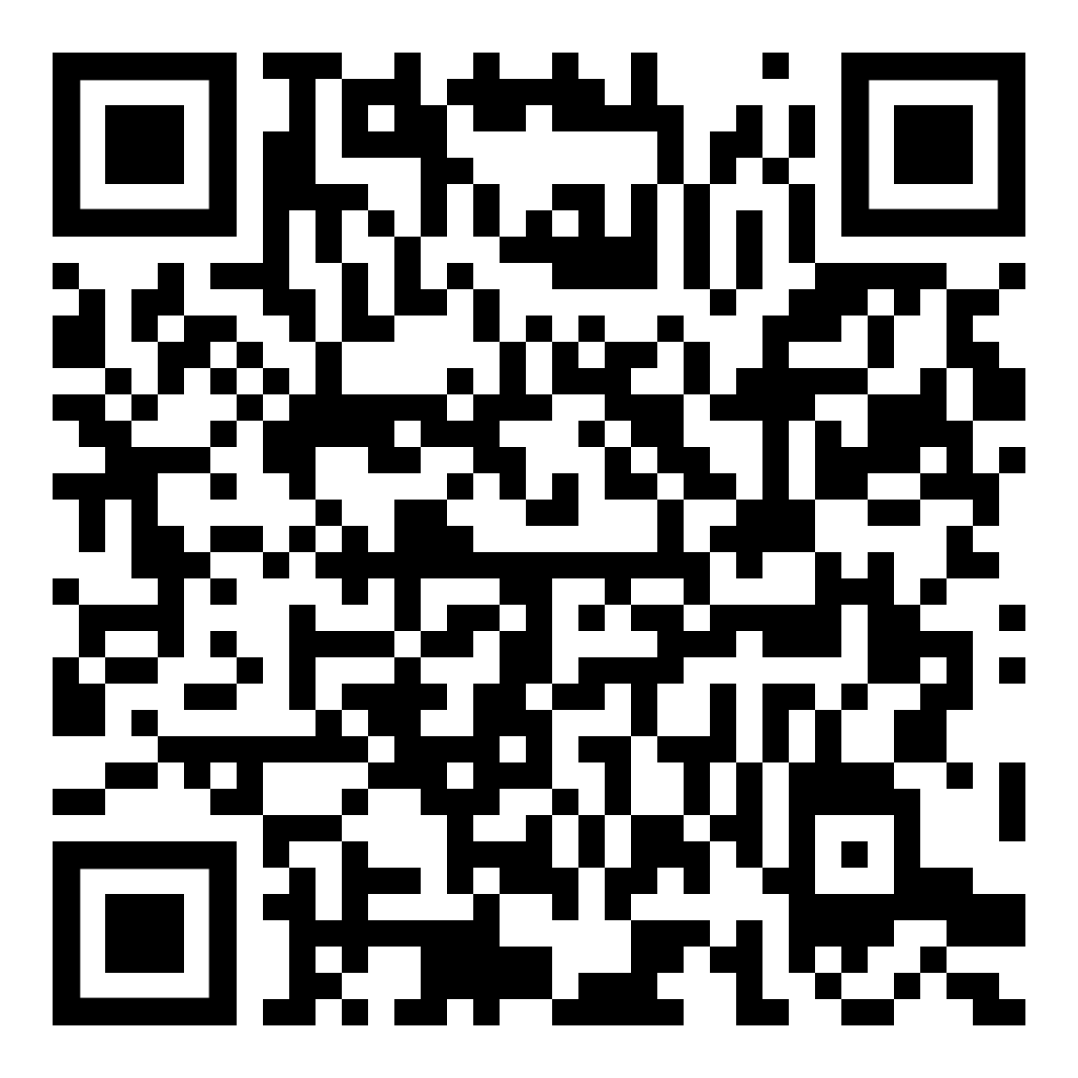

QR Codes
Slides for Today
Repository

Slide 11
Agenda
Brief Recap: From Agentic Workflow to MCP.
What is Model Context Protocol (MCP).
A Taste of MCP Server:
Hands-on: using MCP server from marketplace.
Hands-on: connect to your own MCP server.
Hands-on: write your own MCP server.

Slide 12
Quick Recap of Last Workshop:
A Taste of Agentic Workflow

Slide 13
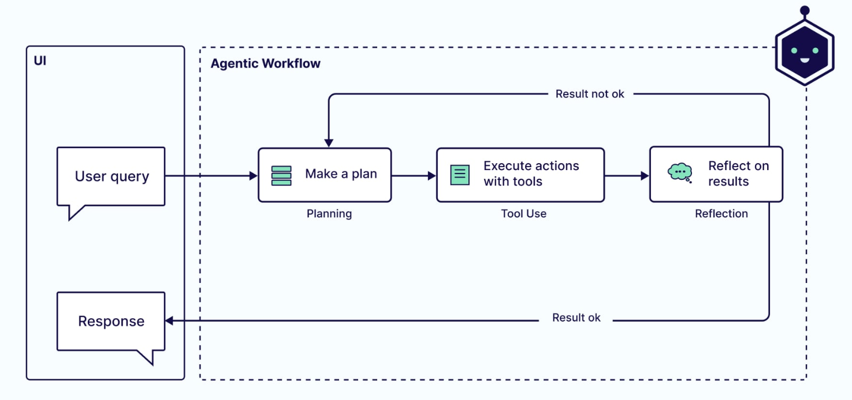
Agentic Workflow
From What Are Agentic Workflows? Patterns, Use Cases, Examples, and More
Notes:
More than chatting
LLM can actually interact with the environment and “do something”

Slide 14
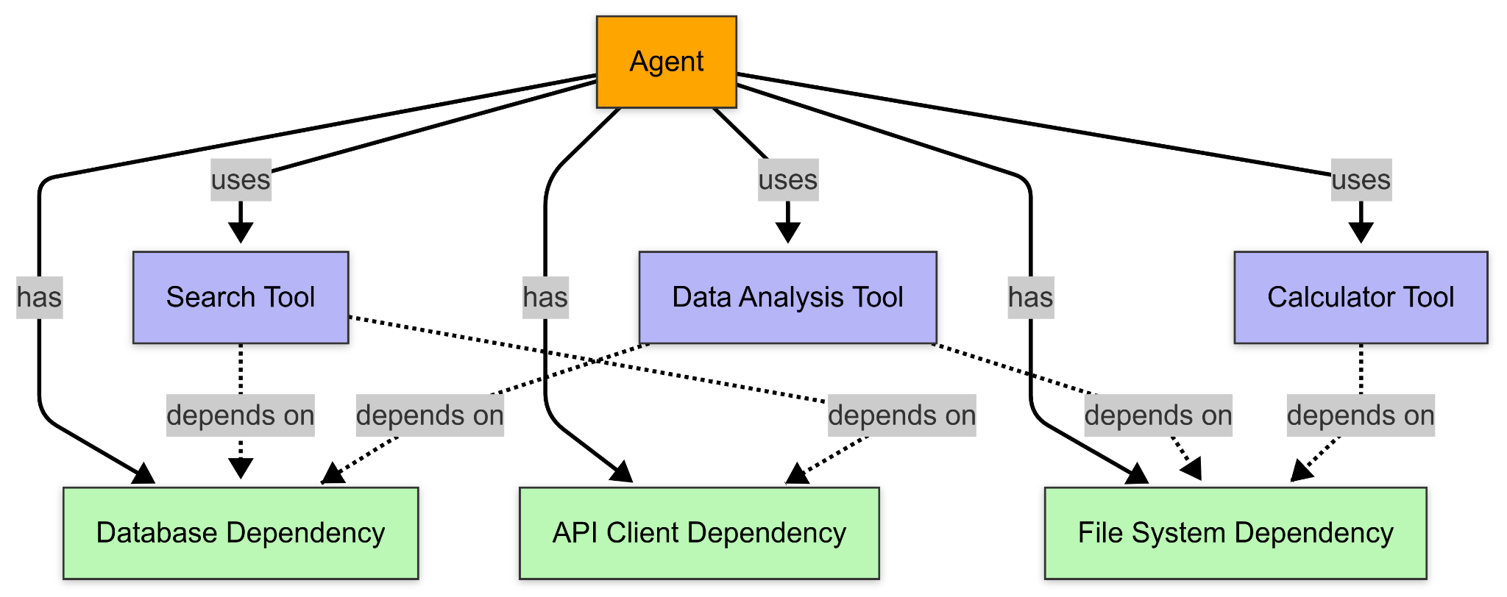
Last Workshop - A Taste of Agentic Workflow
Last workshop we focused on writing tools.
Is there anything we can enhance?
Notes:
flowchart TB
%% Nodes
A[Agent] -->|uses| S[Search Tool]
A -->|uses| D[Data Analysis Tool]
A -->|uses| C[Calculator Tool]
A -->|has| DB[Database Dependency]
A -->|has| API[API Client Dependency]
A -->|has| FS[File System Dependency]
S -. depends on .-> DB & API
D -. depends on .-> DB & FS
C -. depends on .-> FS
%% Classes for coloring
classDef agent fill:#ffa500,stroke:#333,stroke-width:1px,color:#000
classDef tool fill:#b5b5f7,stroke:#333,stroke-width:1px,color:#000
classDef dependency fill:#bbf7b5,stroke:#333,stroke-width:1px,color:#000
%% Assign classes
class A agent
class S,D,C tool
class DB,API,FS dependency

Slide 15
Model Context Protocol (MCP)

Slide 16
Model Context Protocol
First released by Anthropic on November 25, 2024, see Anthropic News.
Standardization (open-source protocol) for resource access and tool execution.
Does not boost the capability of LLMs.
Better organized agentic workflow, unifying the way LLMs access tools or any kind of resources.

Slide 17
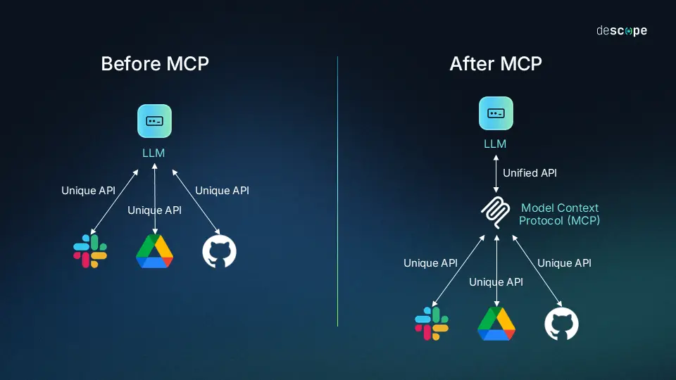
Illustration of MCP
From What Is the Model Context Protocol (MCP) and How It Works

Slide 18
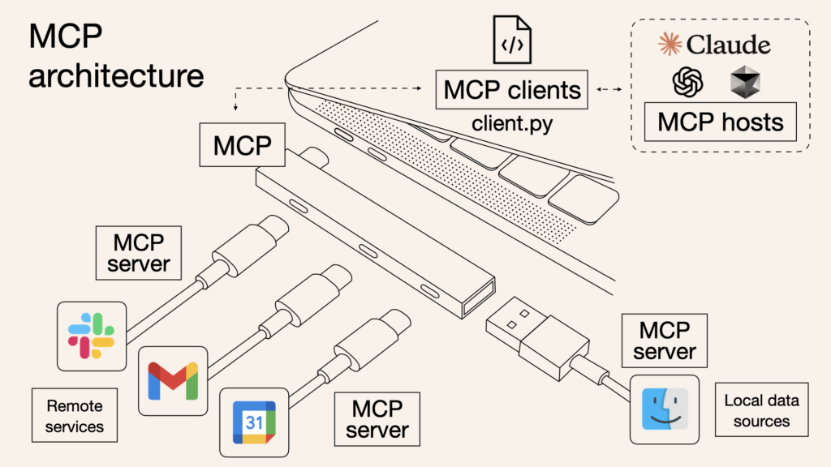
More Simple Illustration
From What is Model Context Protocol (MCP): Explained

Slide 19
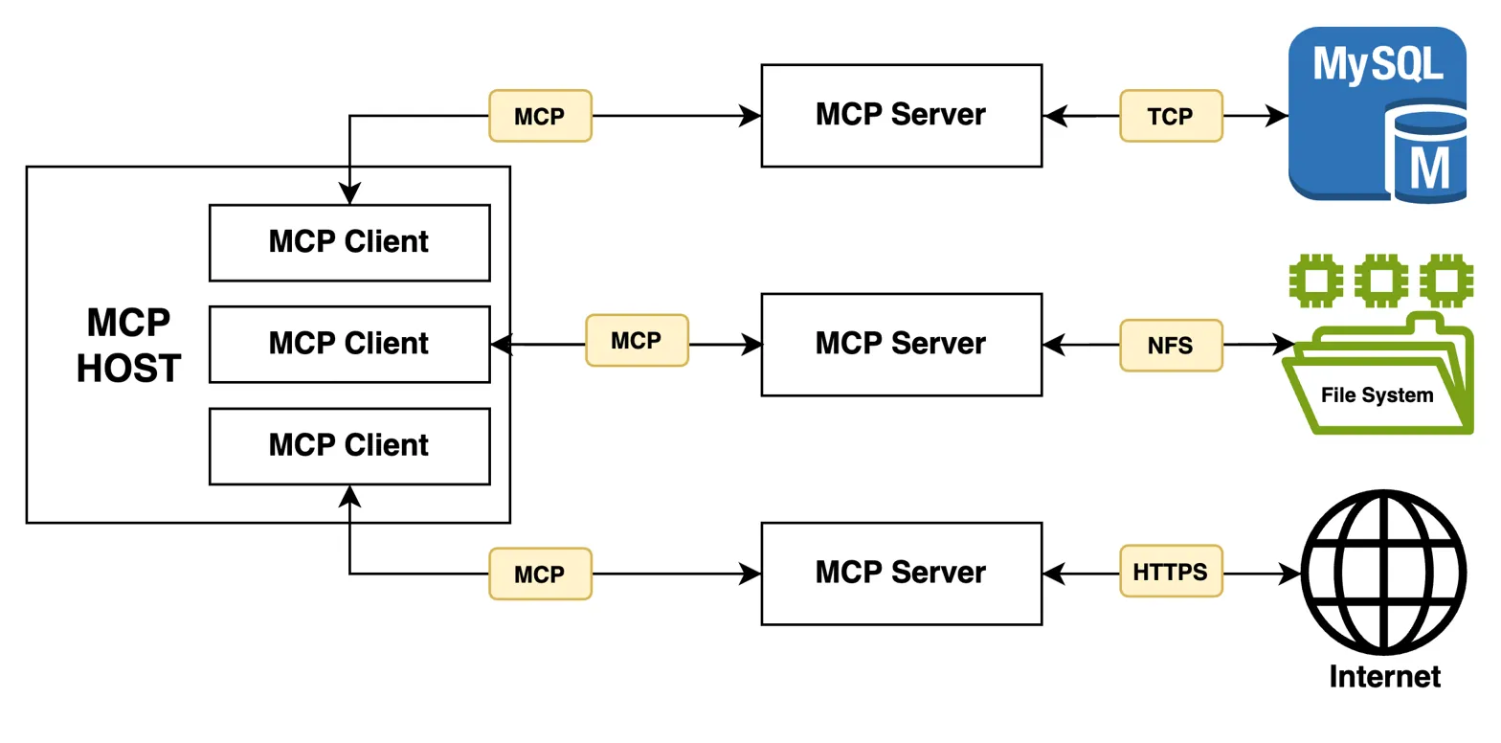
MCP Architecture
From What is MCP? Model Context Protocol Explained

Slide 20
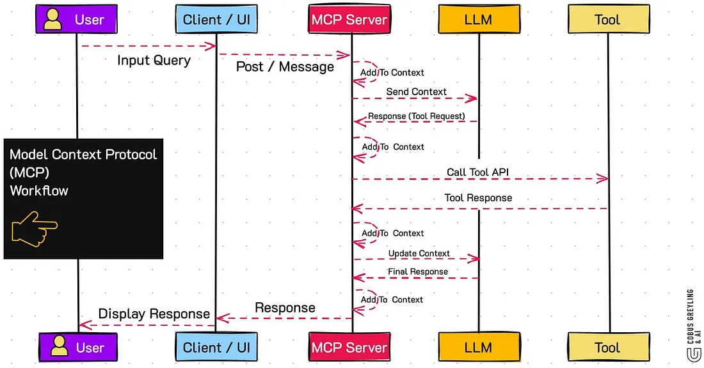
Agentic Workflow with MCP
From Model Context Protocol (MCP)

Slide 21
Do We Really Need MCP?
No but Yes.
MCP does not boost the capability of LLMs.
But it brings standardization to development of agentic workflow.
Standardization often leads to more active development.

Slide 22
A Taste of MCP Server [1]

Slide 23
Sharing MCP Servers
MCP unifies the way LLMs access tools or any kind of resources.
Similar to python modules, MCP servers can now be easily shared, installed, and used.
Notes:
MCP markets: https://mcp.so/

Slide 24
Today Scenario
In the first session of this workshop, we will first showcase how to use MCP servers developed by others, which can be achieved almost no-code.
Learning Objective:
Understand the benefits that MCP brings to us.
Learn new technology for agentic workflow.

Slide 25
Technology Overview
MCP Host: VS Code, an IDE developed by Microsoft.
MCP Client: Cline, a VS Code Extension, open-source AI coding assistant.
MCP Server: Chart Generator, a free chart generation service.

Slide 26
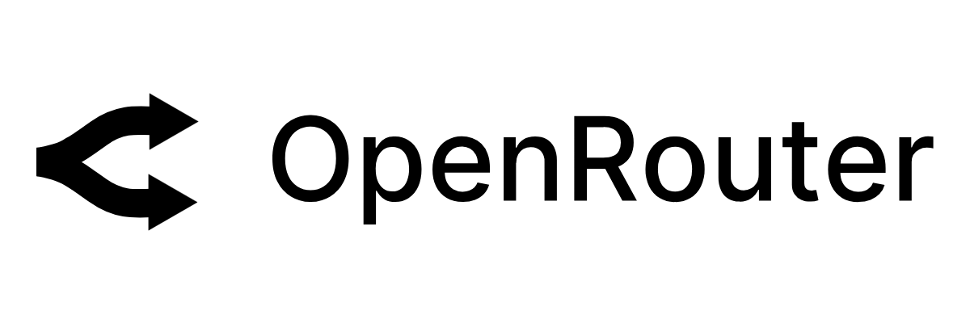
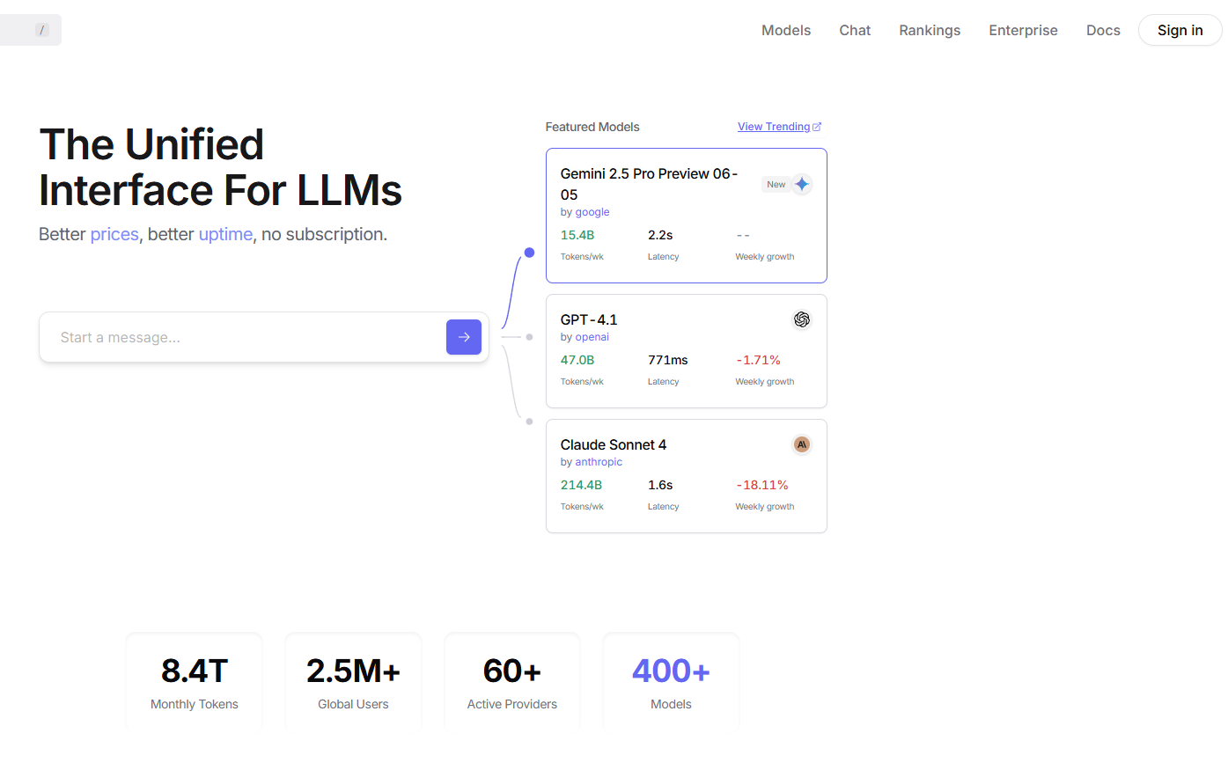
Gain Access to Free SOTA Models
Register an account at https://openrouter.ai/.
Gain access to more free SOTA models.

Slide 27
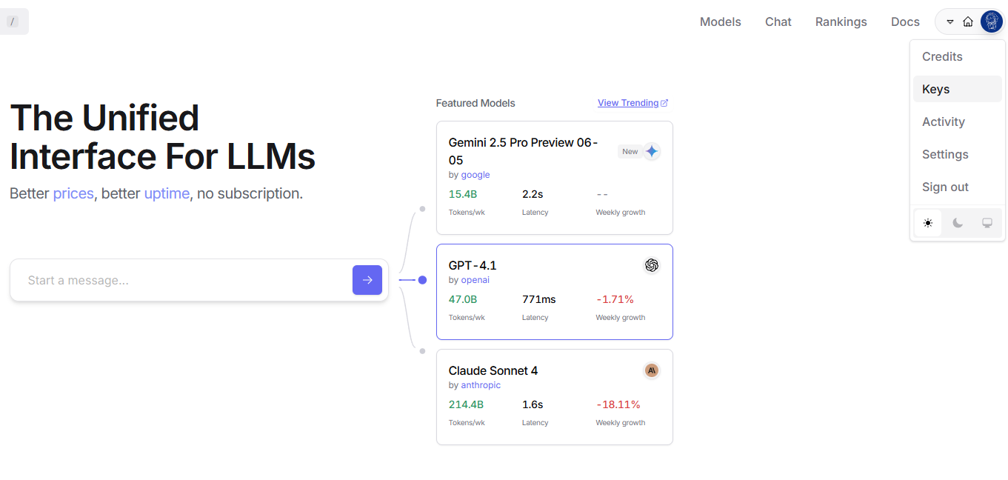
Create an API Key for Cline [1]

Slide 28
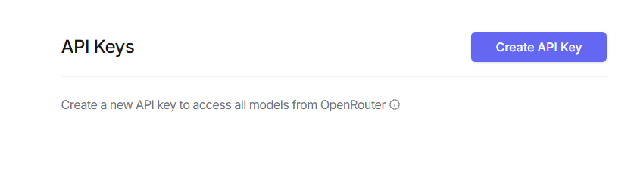
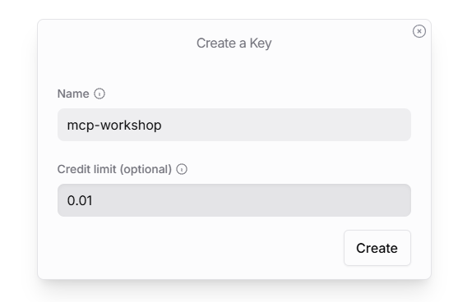
Create an API Key for Cline [2]
You can enter any name you want :)

Slide 29
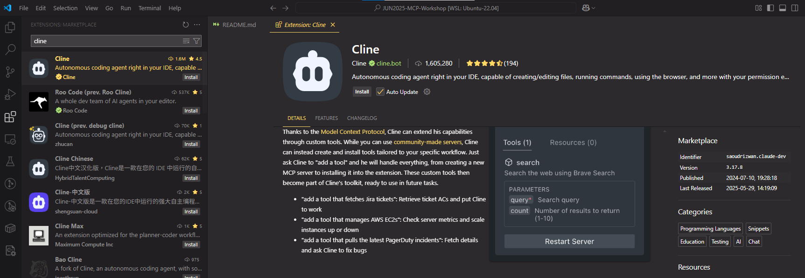
Cline Setup [1]
2. Search for “cline”
3. Install Cline
4. No need to register account
1. Go to VSCode Extension

Slide 30
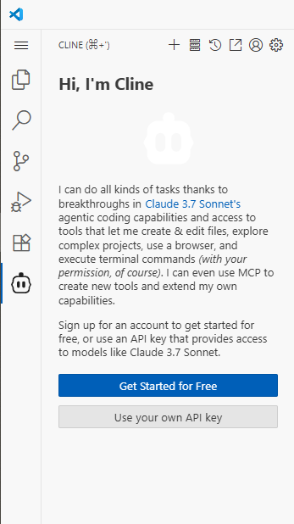
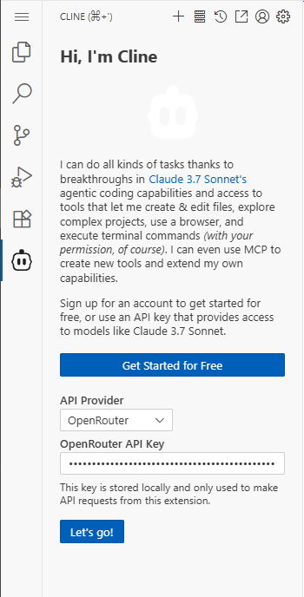
Cline Setup [2]
1. Choose OpenRouter
2. Input the key you obtained

Slide 31
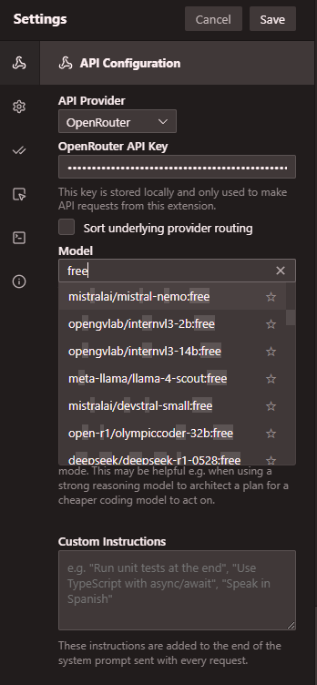
Cline Setup [3]
Choose Your Own Model to Use
Models with free tag can be freely used.
Good enough to use for personal development.
In this workshop, we recommend using
deepseek/deepseek-r1:free

Slide 32
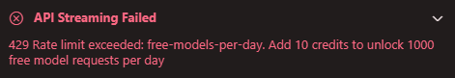
Caution: Rate Limit of OpenRouter
Try not to spam Cline, OpenRouter has a rate limit for free model usage.
If you unfortunately reach this rate limit, please contact helpers for support.
Just let us know if you see this.

Slide 33
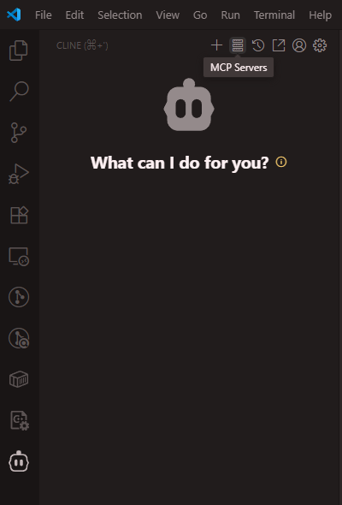
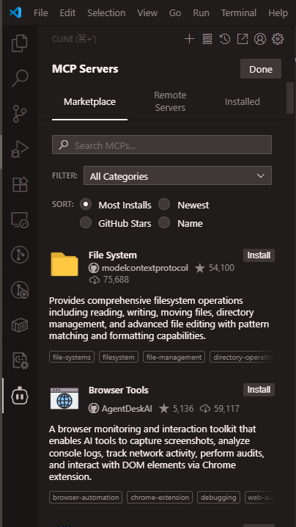
Install MCP from Marketplace [1]
The installation is done by LLM, so it may:
fail, or
install something unexpected in your environment.

Slide 34
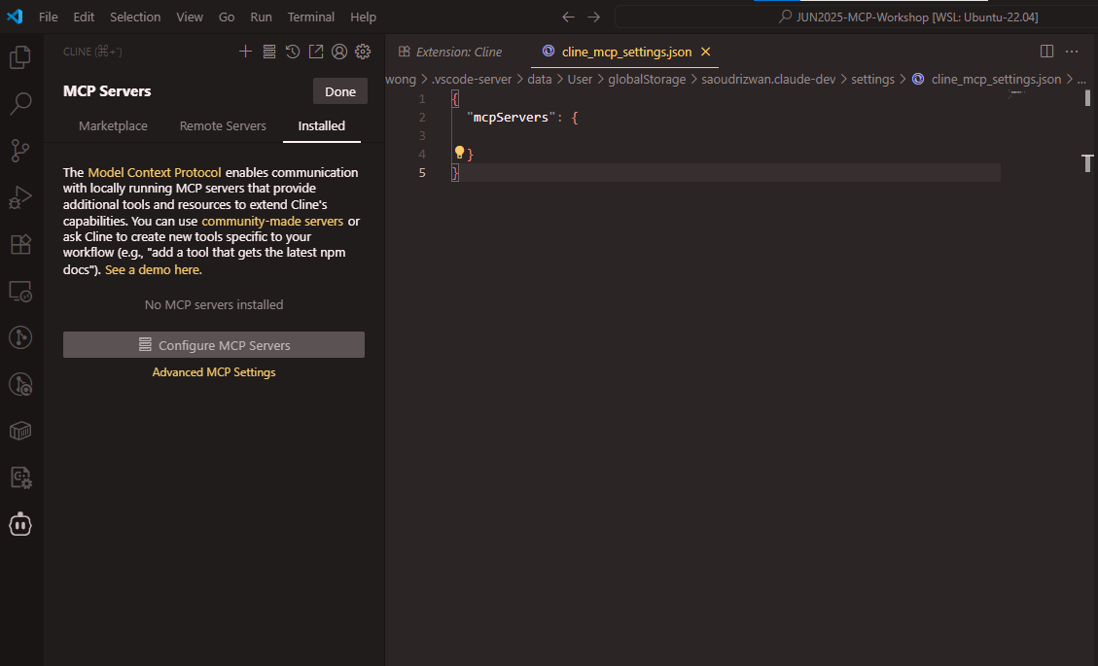
Install MCP from Marketplace [2]
Here we can do manual installation,
which is safer!
(But in this workshop, we will not install anything complicated, so we will let LLM install for us :D)

Slide 35
First Task using MCP Server
Here our goal is to generate some visualizations using utility provided by installed MCP server.
The steps are very simple:
Install MCP Server from marketplace.
Read its functionability.
Prompt the chatbot to generate what we want.

Slide 36
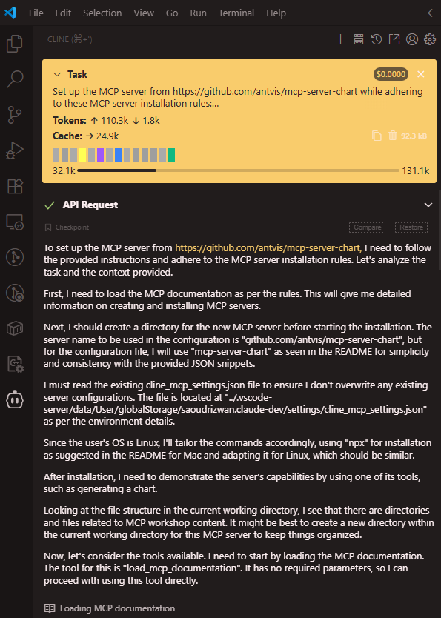
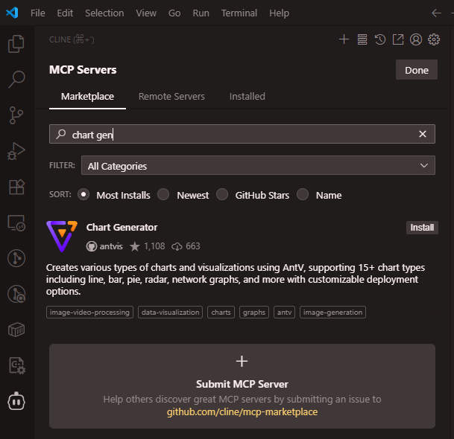
Install Chart Generator
Automatic installation by LLM

Slide 37
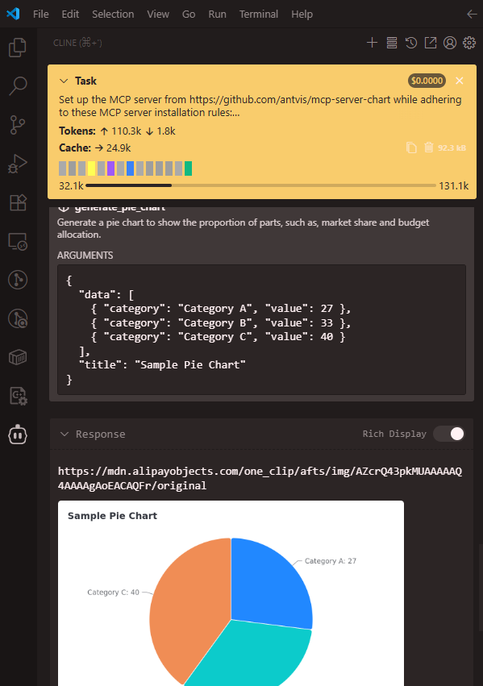
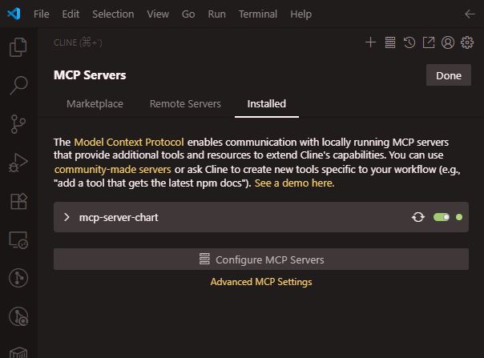
After Installation
Simple example chart by LLM
Should be able to see from MCP Servers

Slide 38
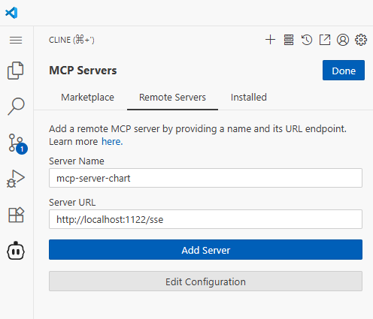
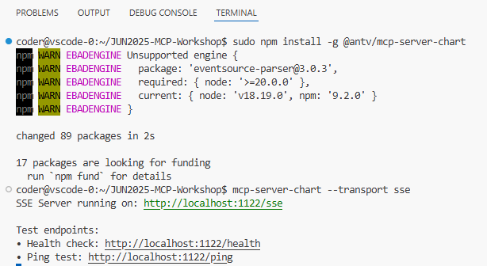
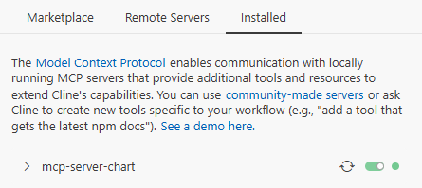
If your Cline failed to install…
2. Manually connect MCP Server
1. Install the MCP Server
3. Check MCP Server Status

Slide 39
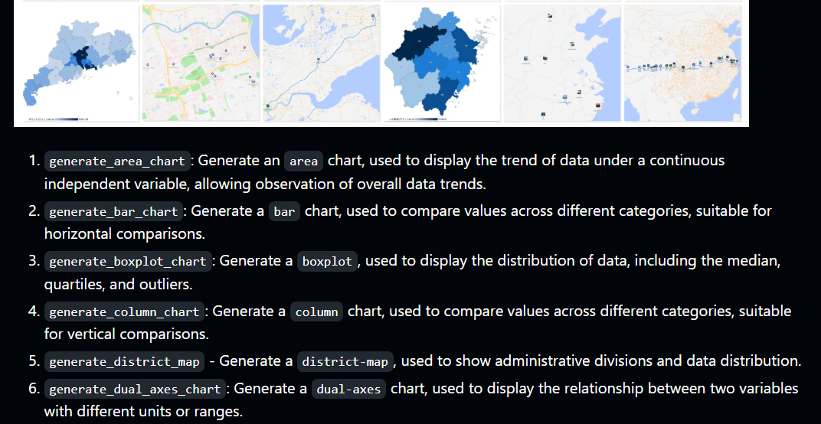
Short Reading on its README
From GitHub

Slide 40
Interact with Chatbot (have access to MCP servers)
Now we do some visualizations on data/customers.csv from last workshop:
Generate a bar chart to show distribution of last name of customers.
Generate a pie chart to show the distribution of customer tier.
Generate a line chart to show number of new customers over time.
During the interactions, try to read the work done by Cline, and get a sense of how the LLM interacts with MCP servers.
Also please feel free to change the model if it keep failing.

Slide 41
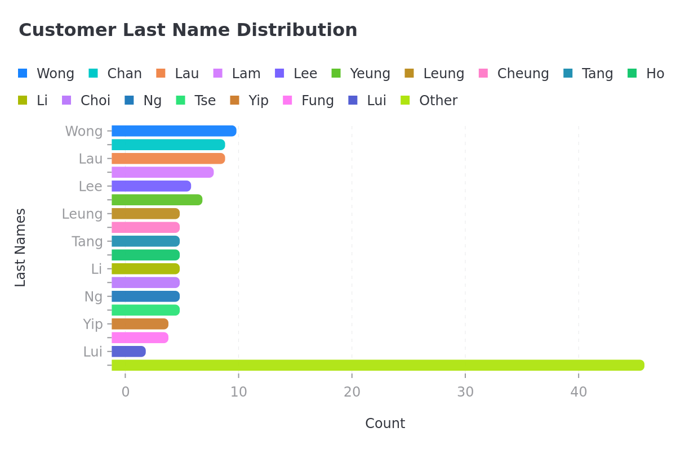
Visualization by MCP [1]

Slide 42
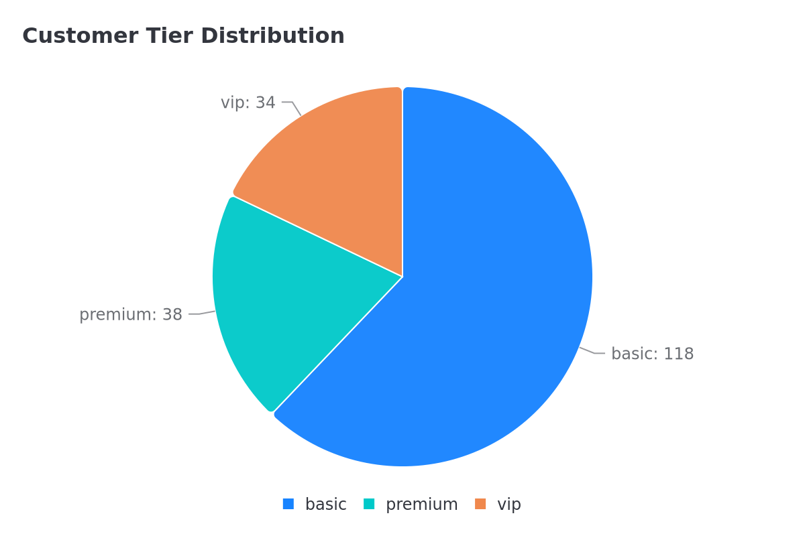
Visualization by MCP [2]

Slide 43
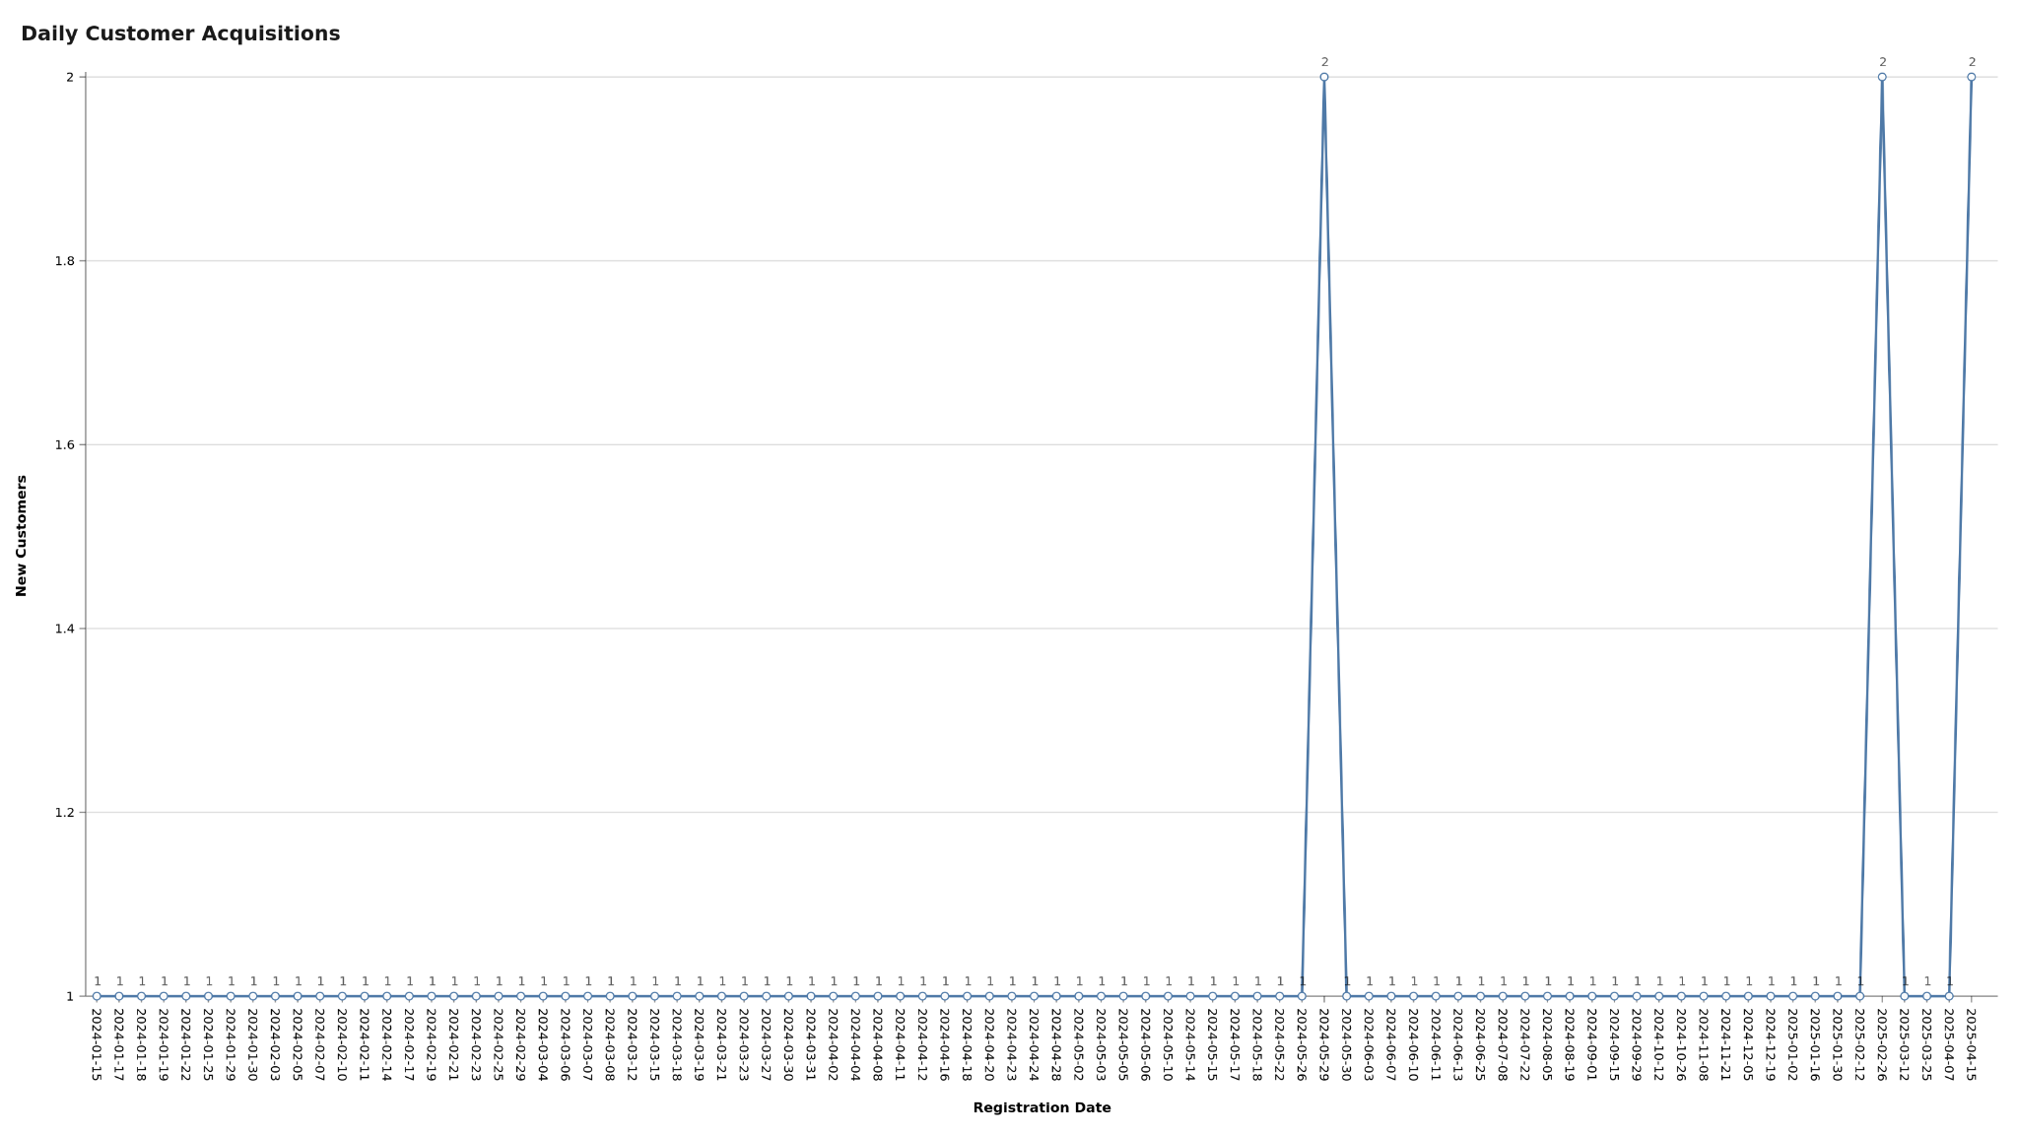
Visualization by MCP [3]

Slide 44
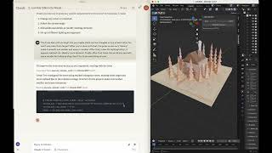
Extra: A Cool Example Use of MCP: Blender
Should be fun.
Try at home if you are interested!

Slide 45
A Taste of MCP Server [2]

Slide 46
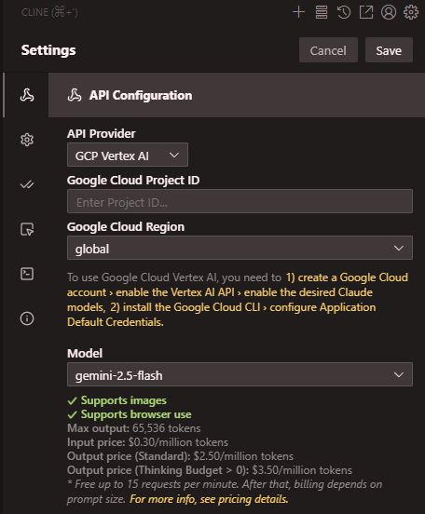
Switching to GCP Vertex AI
As mentioned, OpenRouter has a rate limit for free usage.
We, therefore, will switch to GCP Vertex AI for the later parts of the workshop.
Please use the following parameters:
Google Cloud Region: global
Model: gemini-2.5-flash

Slide 47
Diving into MCP Server
In the second session of this workshop, we will dive into details of how can we write our own MCP Server.
Choice of MCP Framework: FastMCP
Avoid boilerplate code and complex details.
Pythonic.
Focus on building tools.

Slide 48
Communication between MCP Server and Client
Transport | Summary | Limitation
Standard input/output | Print information on console. | Require MCP server and host to be on the same machine.
SSE (Server-sent Events) | Send information via HTTP connection. | Require long-lived, highly available connection. No resumable streams.
Streamable HTTP | Send information via HTTP connection. | Unknown since it is too new (first release in March 2025).
Note: Today we will be using SSE, since Cline does not support MCP server with streamable HTTP yet. But we should expect SSE to be slowly fade out and be replaced by streamable HTTP.

Slide 49
Today Scenario
In the second part of this workshop, we will set up our own MCP server, and use it to interact with some image data prepared in the repository.
Learning objective:
Learn to connect self-written MCP server to Cline.
Explore LLM with extended capability.

Slide 50
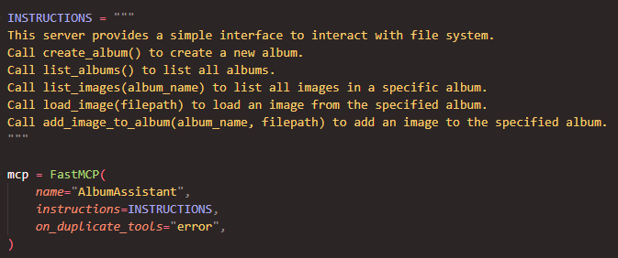
Content of MCP Server

Slide 51
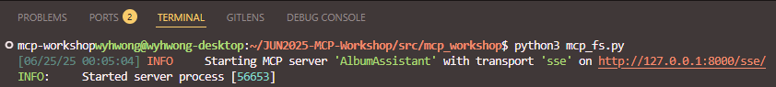
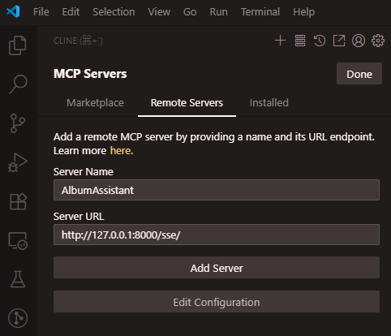
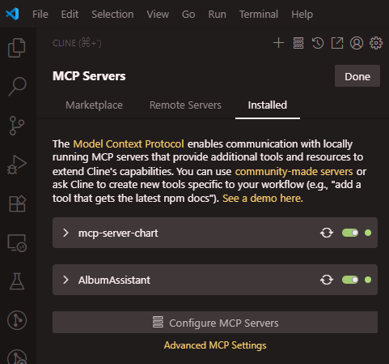
Start and Add MCP Server
If successfully connected

Slide 52
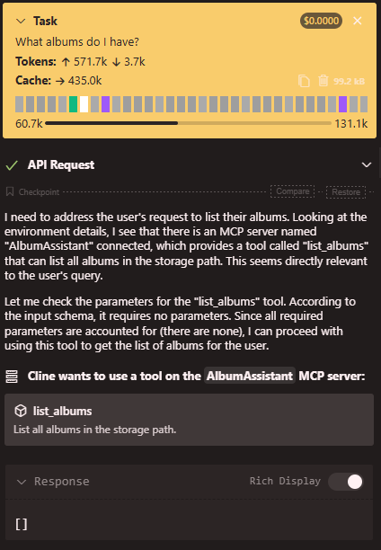
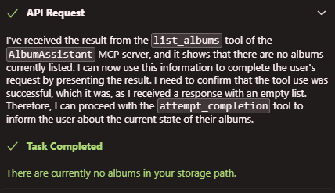
Interact with Cline [1]
The storage is initialized just now, we should not see any album exist.
We have prepared some image data at data/image_data.zip.
In the following task, we will let LLM to handle the photos and put them in various albums.
…
…

Slide 53
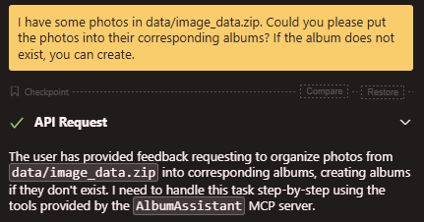


Interact with Cline [2]
Here we specify the data path and ask Cline to handle them, and create albums if needed.
Cline should be able to:
Unzip image data.
Create albums for unzipped photos.
…
…

Slide 54

Interact with Cline [3]
When Cline try to put photos into album, we expect it to fail because of the provided path.
Solution: Ask Cline to provide absolute path.

Slide 55


Interact with Cline [4]
After instructing Cline to provide absolute path, the photos should be moved into the folder successfully.
…

Slide 56

After Cline handled all image data

Slide 57

Let’s check what do we have now [1]
Now there should be 4 albums:
Food
Family
Cats
Dogs

Slide 58


Let’s check what do we have now [2]
…
Now we finally see a cute cat in the album!

Slide 59
A Taste of MCP Server [3]

Slide 60
Today Scenario
In the last part of this workshop, we will write our own MCP server, and again use it to interact with some image data prepared in the repository.
Learning objective:
Learn to set up a MCP server.
Write some code.

Slide 61


Implement mcp_db.py
We have implemented the needed functions for you already.
Description of the MCP server.
Our hint for your code writing.

Slide 62



After Implementation

Slide 63



Interact with MCP Server
Now we can let Cline complete tasks like writing description for the cat photo we just saw.
And keep the description in our PostgreSQL database through MCP server.
…
…

Slide 64
~ END ~

Slide 65
Q & A

